Slide 1


Simple view and complex view in sql (structured query language)

Slide 2
UNDERSTANDING VIEWS IN SQL
SIMPLE VIEW: A "Simple View" in SQL refers to a virtual table generated from a single SELECT statement. It encapsulates the result of the query, allowing users to treat it like a regular table, querying it with SELECT, INSERT, UPDATE, or DELETE statements.
COMPLEX VIEW:A "Complex View" in SQL involves more intricate logic, typically incorporating multiple tables, subqueries, joins, aggregations, or other complex operations. It provides a more nuanced and detailed representation of the data, often requiring more processing power and expertise to manage effectively.

Slide 3
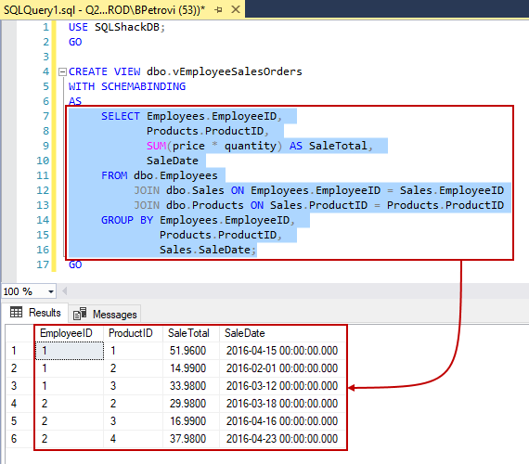
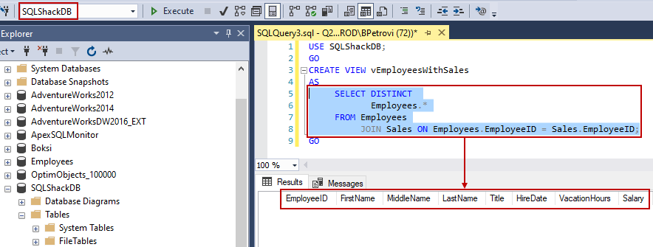
Simple view and complex view
Query representation of a complex view
Query representation of a simple view

